Slide 1
ICS第四次小班课 10.29
Processor Arch:
ISA & Logic Sequential
MADE BY: Zhong Zhineng & You Zhenbang
TA：Wenhao Tang

Slide 2
Processor Arch: ISA

Slide 3
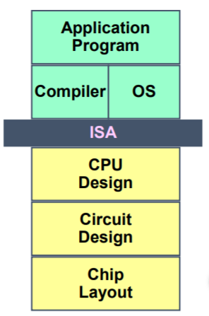
ISA
“The ISA serves as the boundary between the software and hardware.”
—— Computer Architecture: A Quantitative Approach
Instruction set architecture is the structure of a computer that a machine language programmer (or a compiler) must understand to write a correct (timing independent) program for that machine.
—— IBM introducing 360 (1964)

Slide 4
ISA
1964，Amdahl、Blaauw和Brooks 在Architecture of the IBM system 360一文中，给出了“体系结构”的定义：
The term architecture is used here to describe the attributes of a system as seen by the programmer, i.e., the conceptual structure and functional behavior, as distinct from the organization of the data flow and controls, the logical design, and the physical implementation.
ISA包括各种状态单元、指令集和他们的编码、一组编程规范和异常事件处理

Slide 5
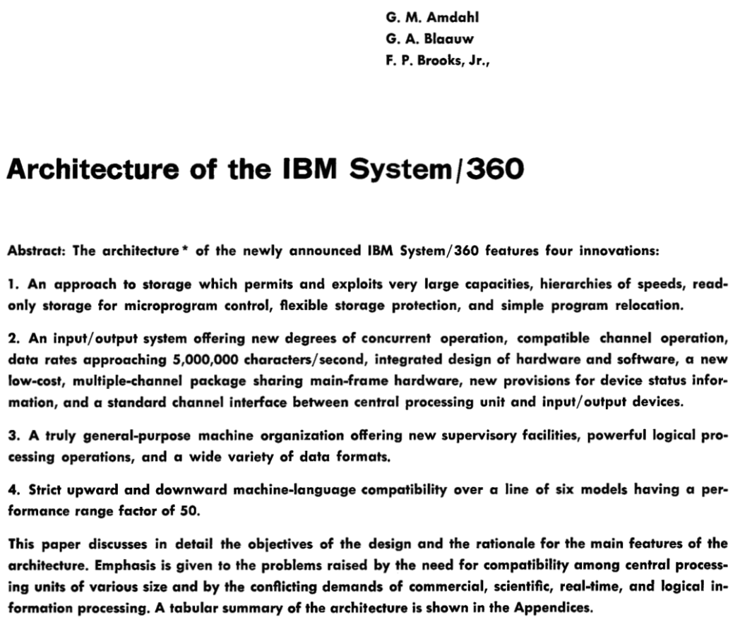
ISA

Slide 6
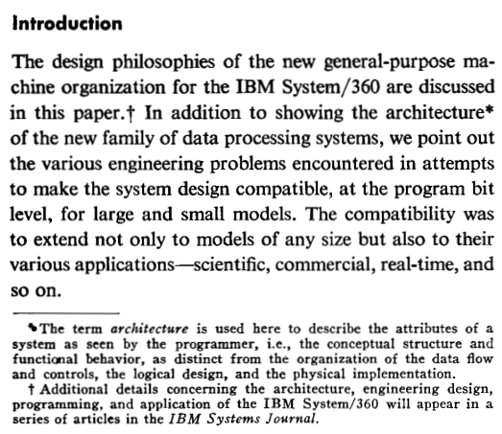
ISA

Slide 7
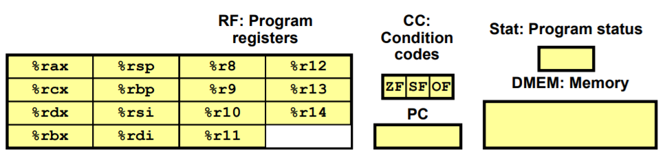
Y86-64 Programmer-Visible State
Program Registers
Memory
Condition Codes
Program Status
Program Counter

Slide 8
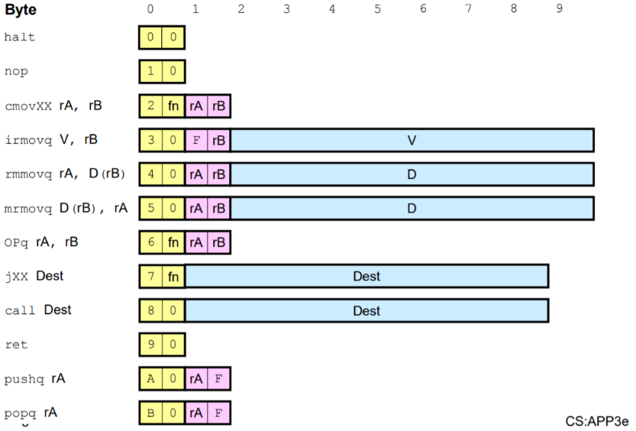
Y86-64 Instruction Set & Encoding
Instruction Code
Function Code
Immediate

Slide 9





RISC vs. CISC
Examples
CISC
x86
RISC
ARM
RISC-V
MIPS

Slide 10
RISC vs. CISC
CISC | RISC
Multiple formats for specifying operands. | Simple addressing formats.
Arithmetic and logical operations can be applied to both memory and register operands. | Arithmetic and logical operations only use register operands. Memory referencing is only allowed by load instructions.
Implementation artifacts hidden from machine-level programs. | Implementation artifacts exposed to machine-level programs.
Condition codes. | No condition codes.
Stack-intensive procedure linkage. | Register-intensive procedure linkage.

Slide 11
RISC vs. CISC
CISC | RISC
Easy for compiler. | Need support of advanced compiler.
Fewer code bytes. | More code bytes.
More friendly to assembly code programmer. | Less friendly to assembly code programmer.
Currently dominates markets of PC processors and server processors | Currently dominates markets of embedded processors

Slide 12
Processor Arch: Logic

Slide 13
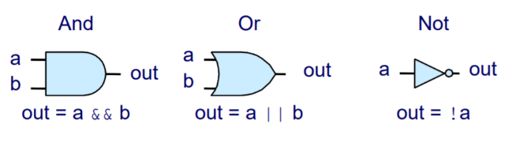
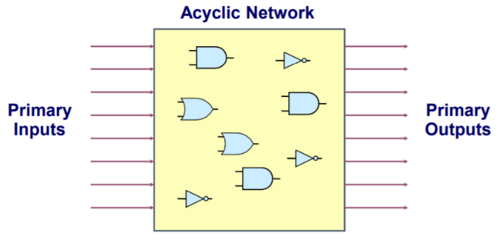
Logic Gates and Combinational Circuits
Outputs are Boolean functions of inputs
Respond continuously to changes in inputs
Continuously responds to changes on primary inputs
Primary outputs become (after some delay) Boolean functions of primary inputs

Slide 14
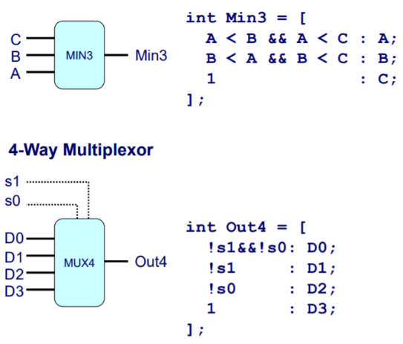
a, b, s: Bit-Level Representation
A, B: Word-Level Representation
Hardware Control Language (HCL)
HCL Examples:
bool eq = (a&&b)||(!a&&!b)
bool Eq = (A == B)
bool res = A in {item1, item2}
Bit-Level Multiplexor:
bool out = (s&&a)||(!s&&b)
Word Multiplexor:
int Out = [
s : A;
1 : B;
];
HCL Word-Level Examples:

Slide 15
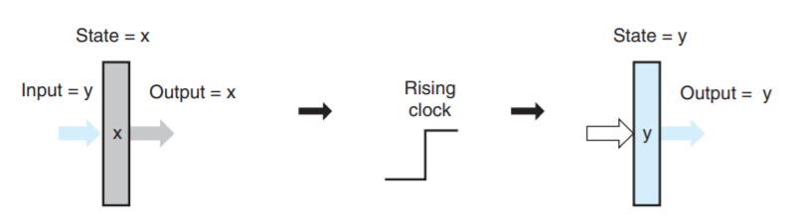
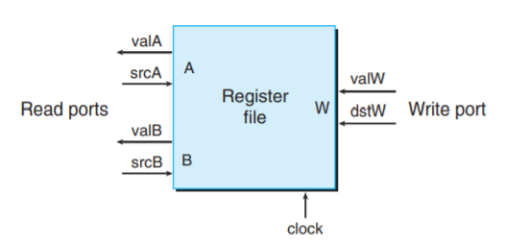
Registers & Register Files
register
register
file

Slide 16
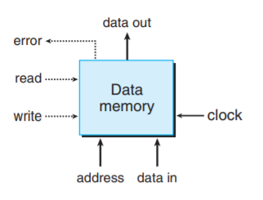
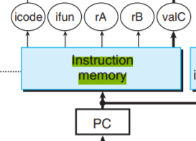
Memories
data memory
instruction
memory

Slide 17
Processor Arch: Sequential

Slide 18
Basics
5 stages
Fetch
Decode
Execute
Memory
Write back
PC update
States
PC
CC
Stat
Register files
Memories

Slide 19
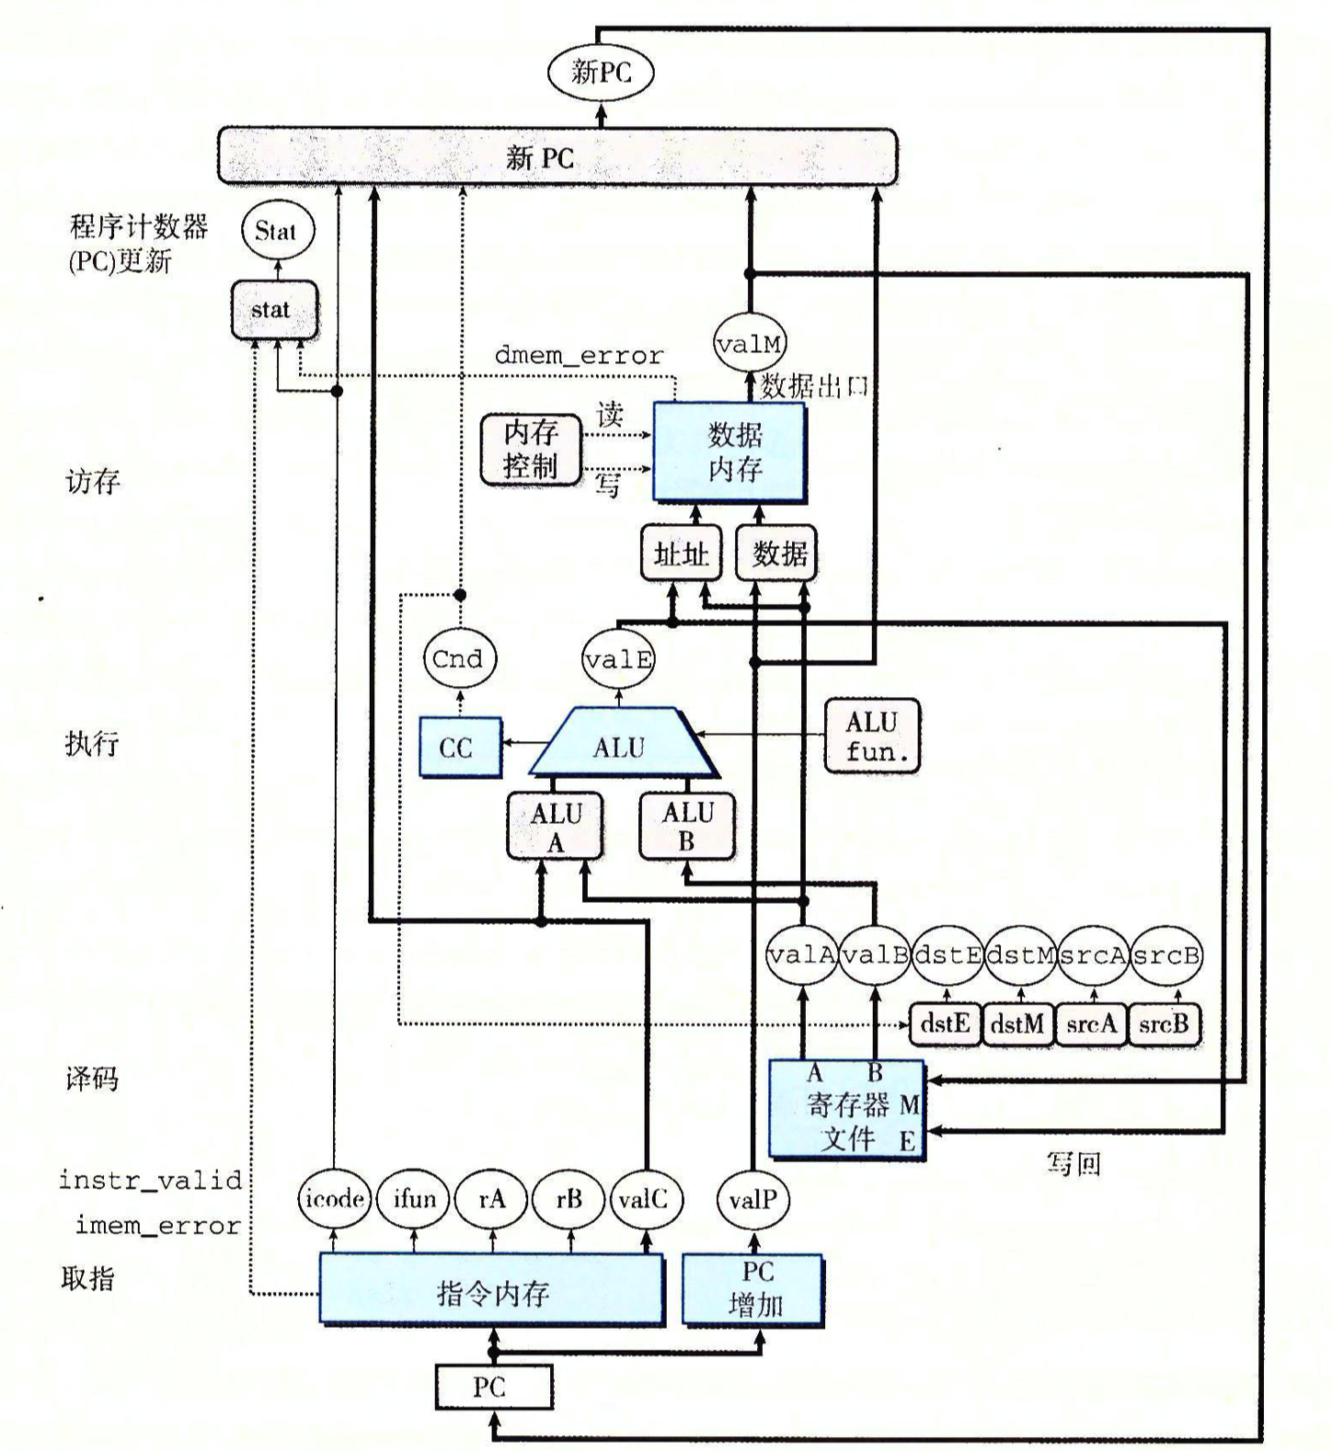
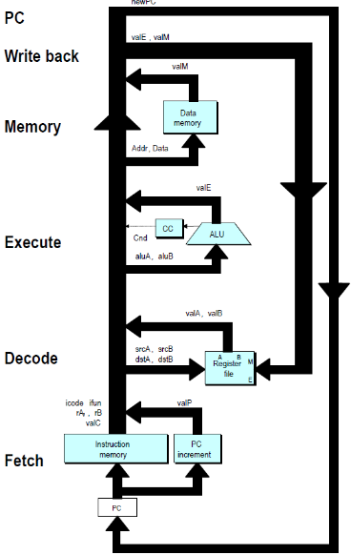
SEQ Hardware

Slide 20
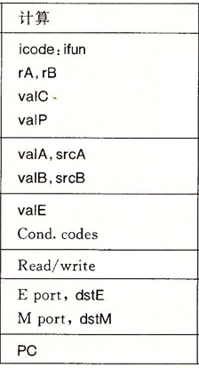
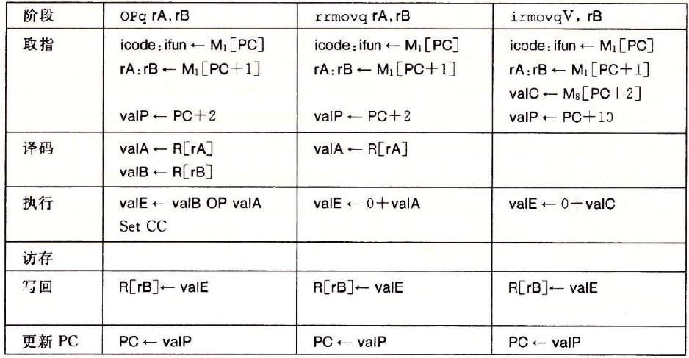
Opq, rrmovq, irmovq

Slide 21
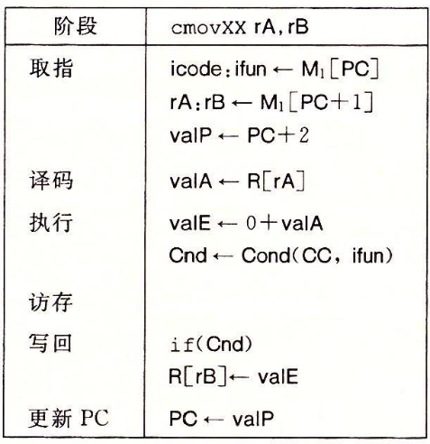
cmovXX

Slide 22
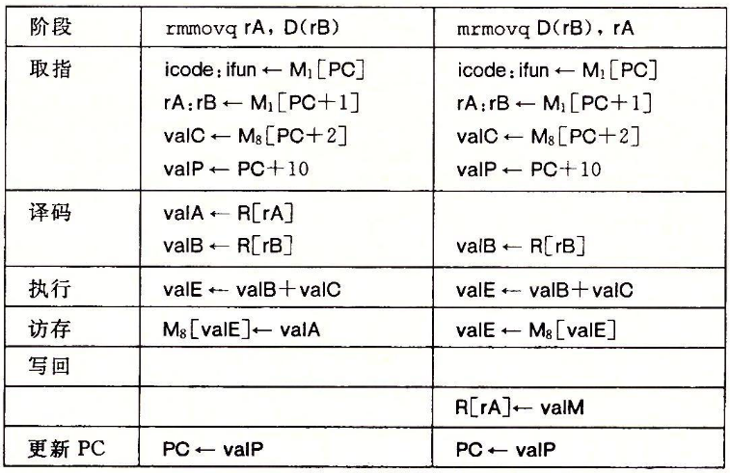
rmmovq, mrmovq

Slide 23
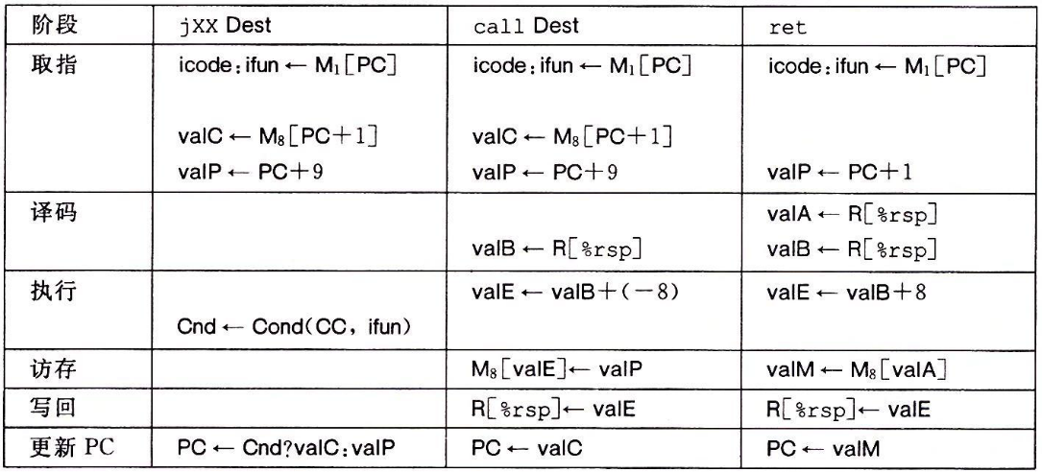
jXX, call, ret

Slide 24
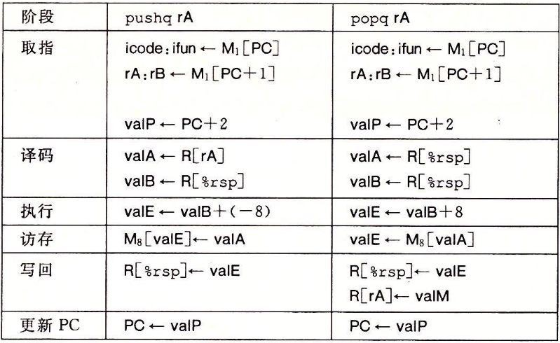
pushq, popq

Slide 25
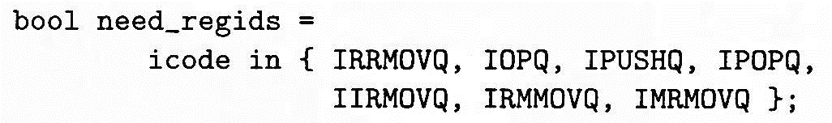
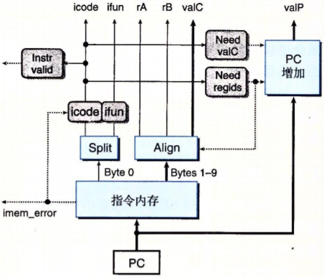
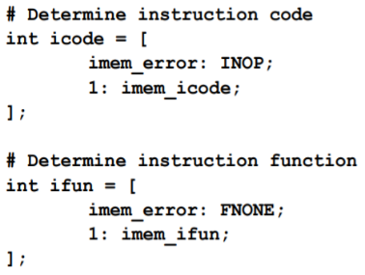
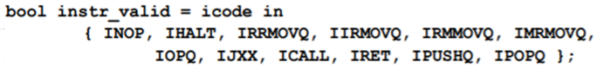
Fetch
HCL:

Slide 26
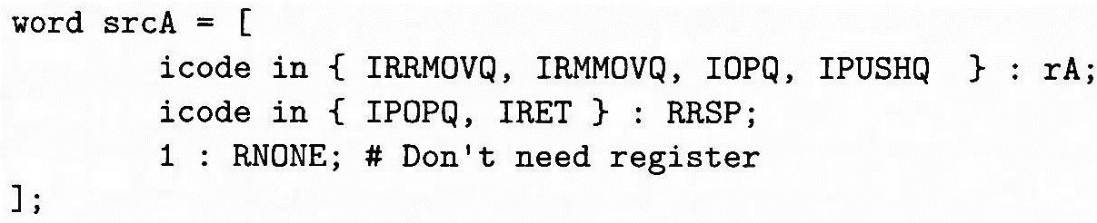
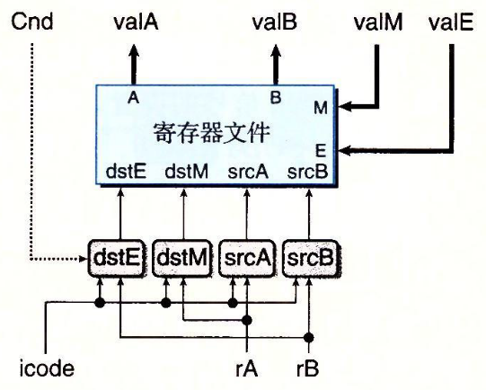
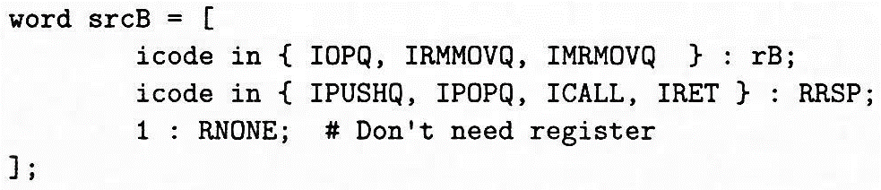
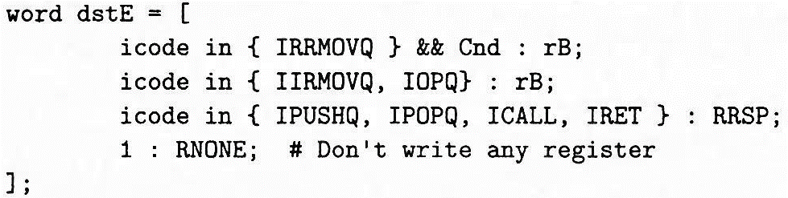
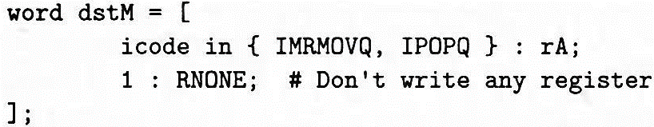
Decode/Write back
HCL:

Slide 27
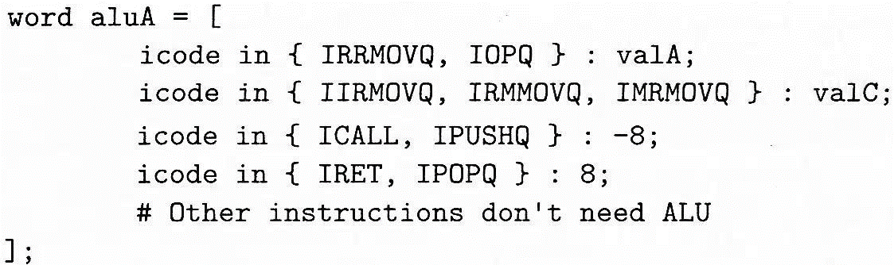
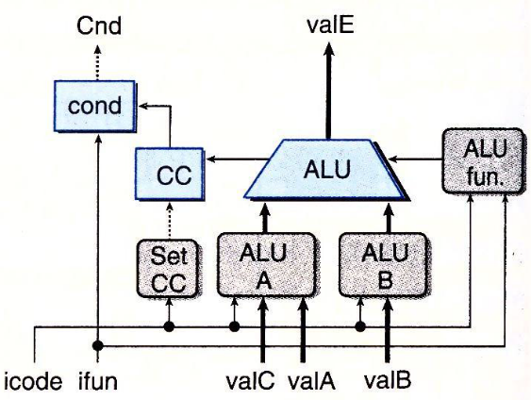
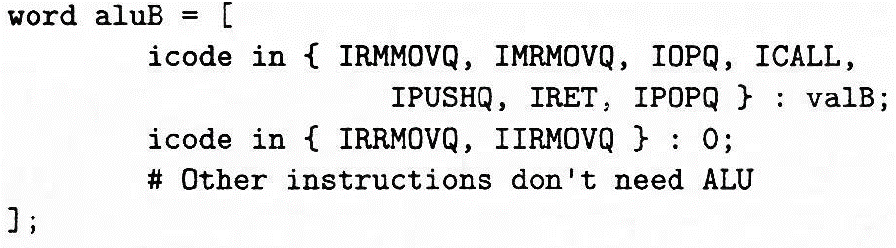
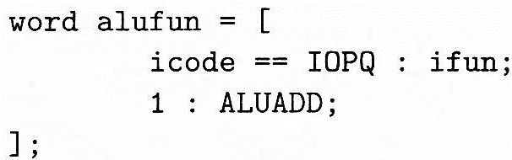
Execute
HCL:

Slide 28
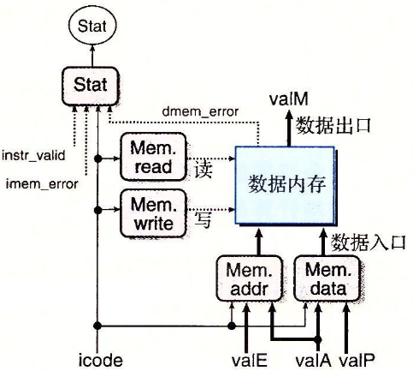
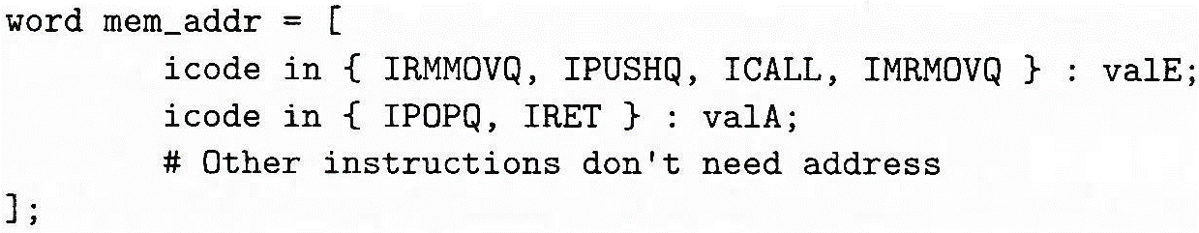
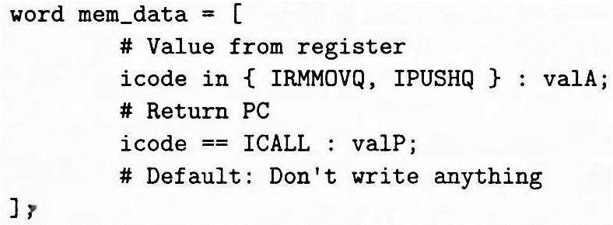
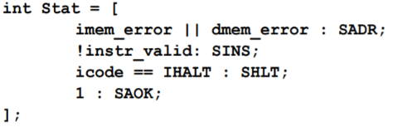
Memory
HCL:

Slide 29
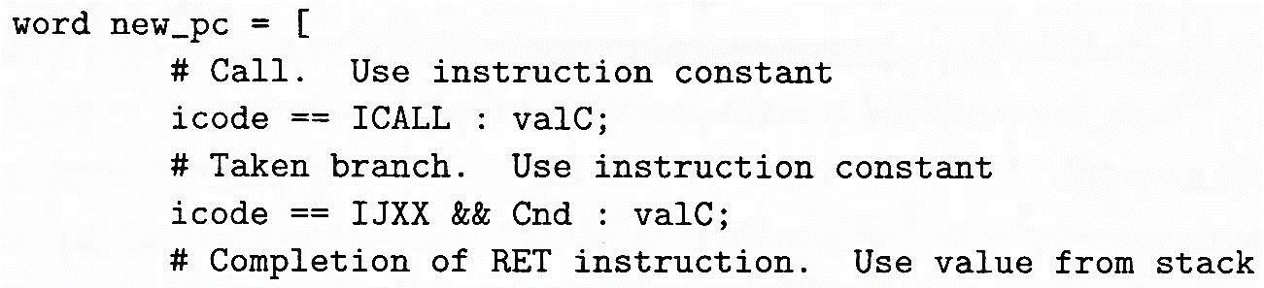
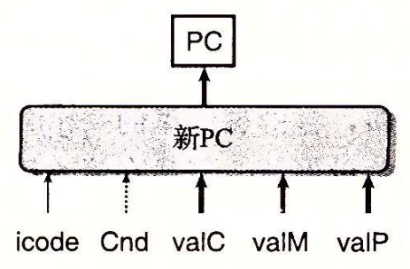
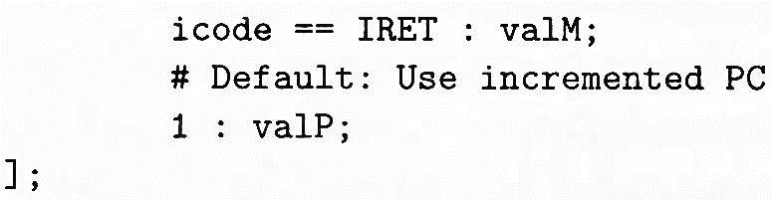
New PC
HCL:

Slide 30
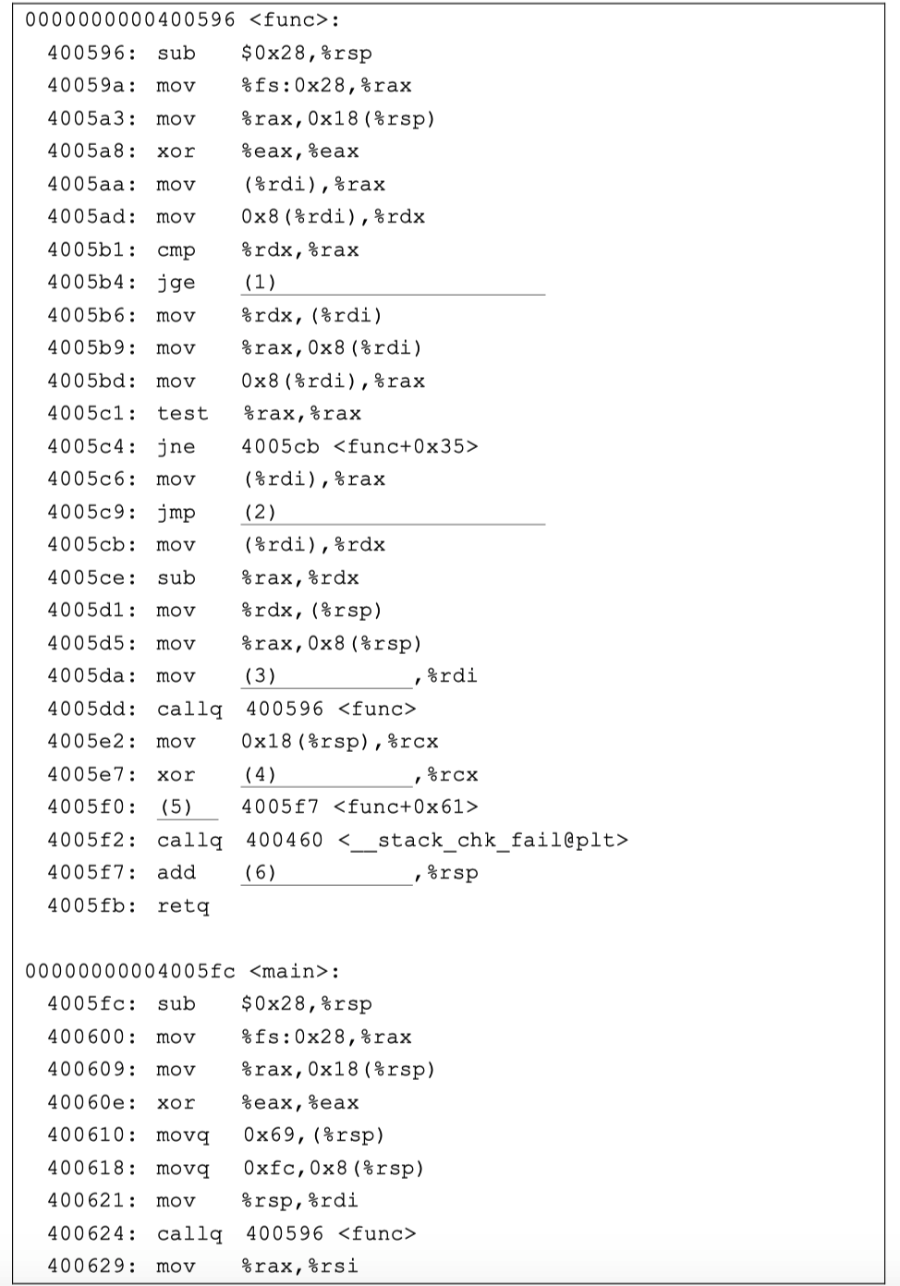
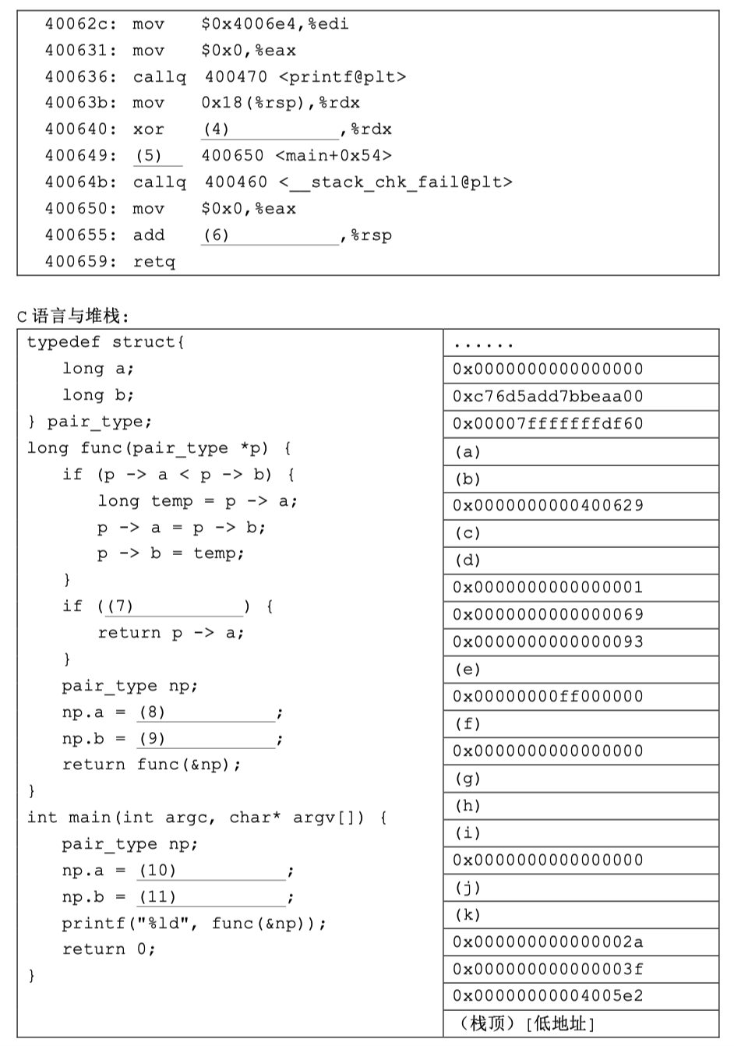
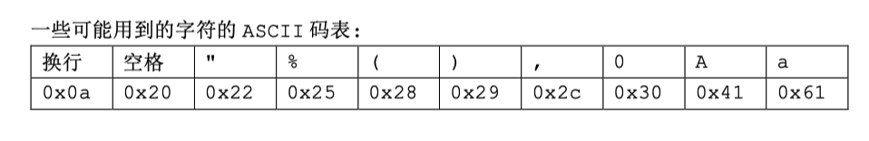
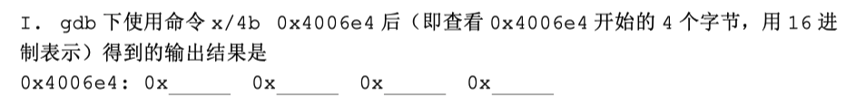

Slide 31
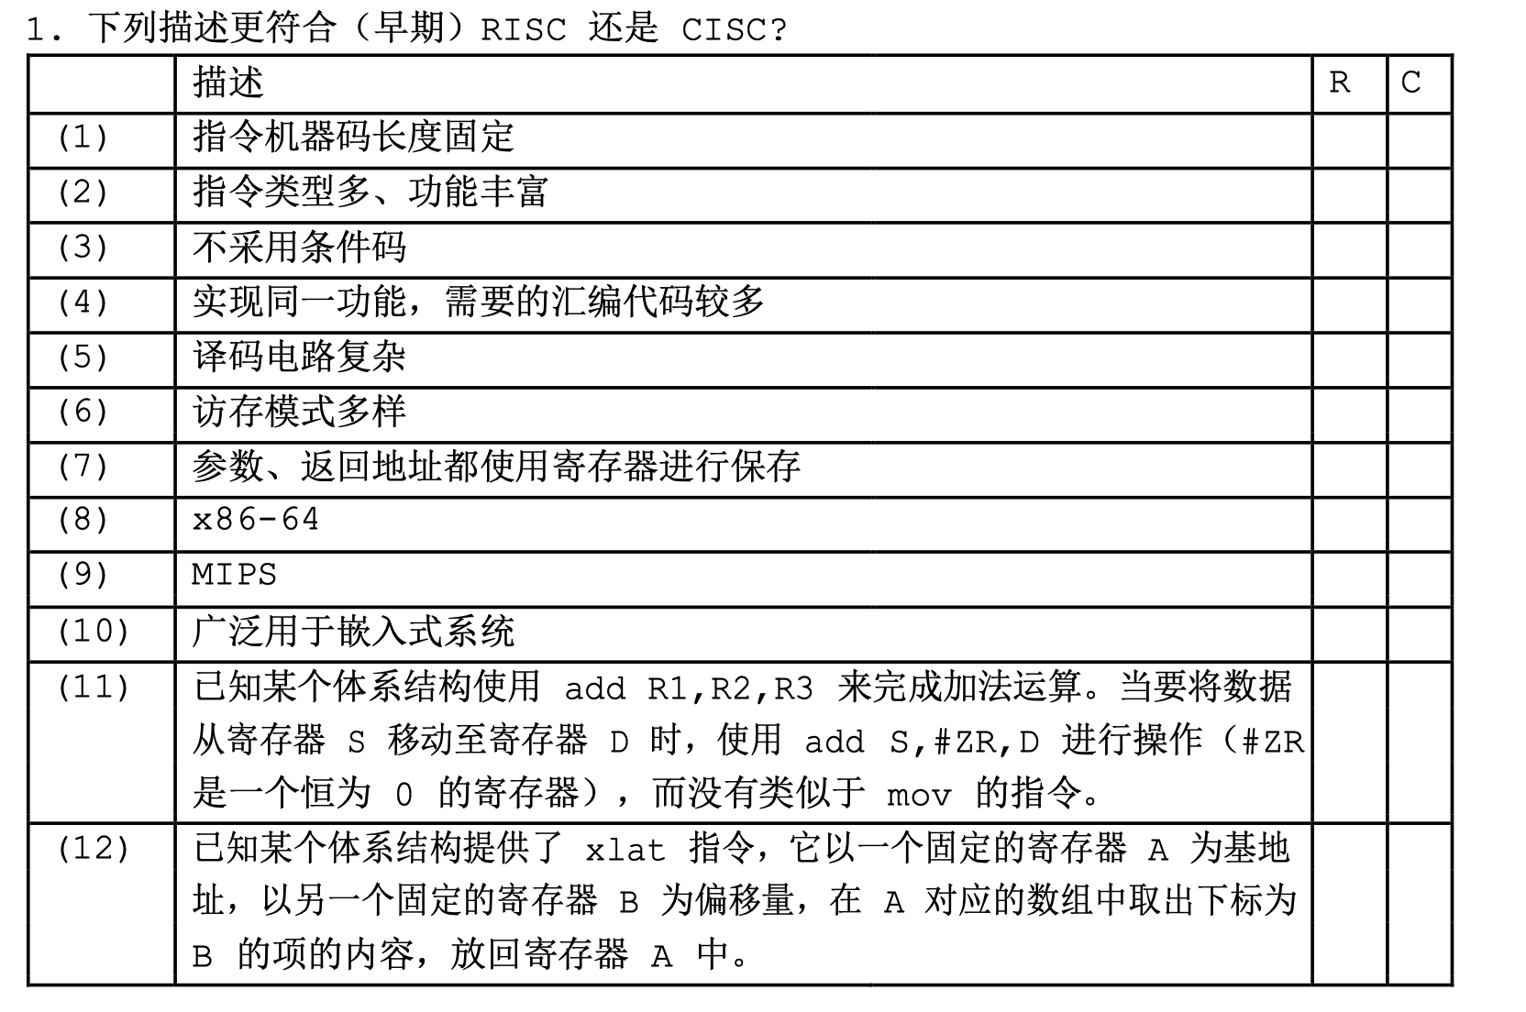

Slide 32
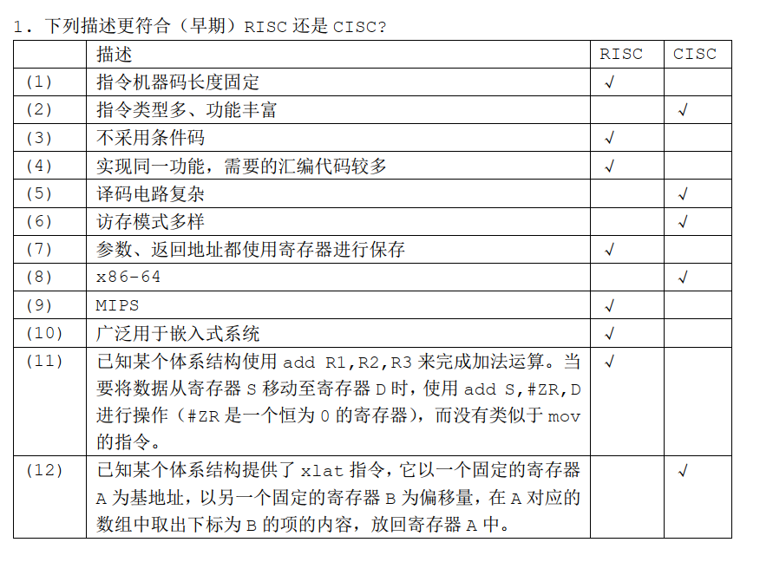

Slide 33
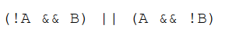
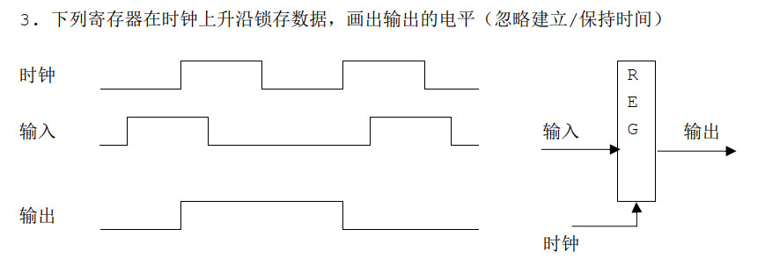

Slide 34
